Slide 1
Volunteer Best Practices
Make it easy and compelling for members to volunteer
AFCEA Hampton Roads leverages Signup.com, a no-cost, open source tool to invite, register, schedule, remind and track volunteers
Schedule is easily built and customized within the system
Includes position/duties, dates, times, and records contact info
Registration is “one-click” simple
Printable report that can be loaded into a spreadsheet
System generated reminder for volunteer shifts and thank you messages
Volunteer incentives
Complementary participation for the event: i.e. register for a set # of hours and event registration is free
Provide polo/golf jerseys, T-shirts, ball caps or other event-appropriate attire
Opportunity to show yourself as a dedicated AFCEAN

Slide 2
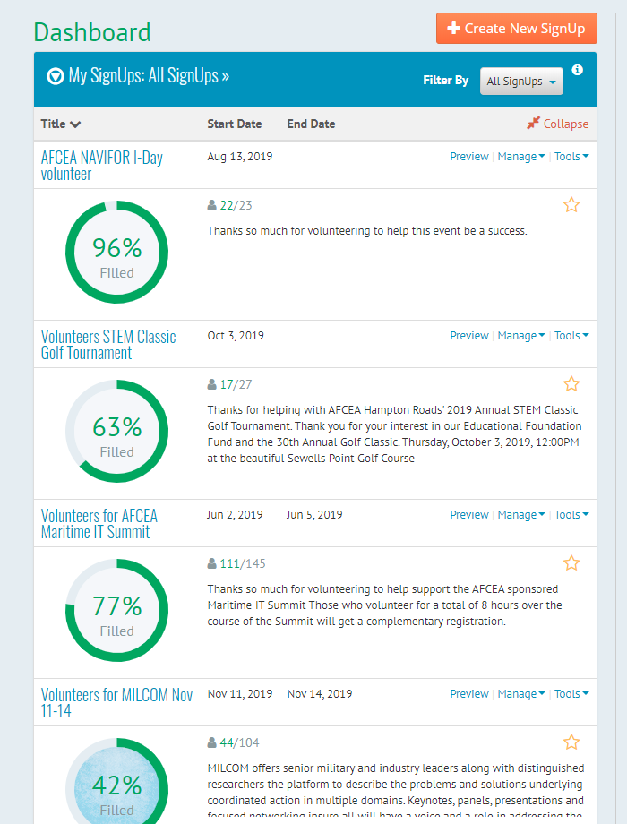
Signup.com, Volunteer Management Tool (free)

Slide 3
Volunteer Success Stories
AFCEA Hampton Roads has used this system for the past two years
DON IT East/Maritime IT Summit
Industry Days
Annual STEM Classic golf fundraiser
Other manpower-intensive events
AFCEA International integrated this practice into MILCOM 2019
The ease of registration usually results in the volunteer positions getting filled in advance
This is a repeatable process that can be replicated for any event

